Slide 1
Curriculum Fair

Slide 2
What do you need to graduate?
24 Credits
4 English
4 Math (must include Algebra 1 and Geometry)
3 Science (must include Biology)
3 Social Studies (U.S. Gov, World History, U.S. History, and Economics)
1 credit of HOPE or earn ROTC or Athletic waiver
1 credit of Performing/Fine Art/Career & Technical
.5 credit of Personal Financial Literacy
2.0 GPA (“C” average)
Passing score on 10 FAST ELA Reading & BEST Alg. 1 EOC
***** Graduation requirements are subject to state legislation****

Slide 3
Don’t I need foreign language to graduate?
Not Required for high school graduation
At least 2 years of the same foreign language are required by most 4-year colleges and universities
Having a 3rd year of a foreign language is preferred by most major colleges and universities.
College prep course of study requires 2 years of a foreign language.
Bright Futures Scholarships
The 2 top tier scholarships (Florida Medallion & Florida Academic) require 2 credits of the same foreign language.

Slide 4
Programming
Core courses are programmed based on 8th-grade teacher recommendations, grades, and test scores.
Math Placement based on FAST Math Scores, grades, and teacher recommendations.
Levels 1 & 2 - Algebra 1A
Level 3 and higher - Algebra 1, Algebra 1 Hon
Geometry – Students currently in Algebra 1
Science
Levels 1 & 2 - Environmental Science
Levels 3, 4 and 5 - Biology Honors, Biology, AP Biology
AP Biology - A’s every quarter in Physical Science Honors
Social Studies
Levels 1 & 2 – U.S. Government (1 semester)
Levels 3, 4 & 5 – AP Human Geography or AICE Thinking Skills

Slide 5
Programming
Reading
Level 1 & 2 - Intensive Reading
Level 3 - Semantics Honors (1 semester)
Level 4 & 5 - No reading class
Acceleration Courses
AP (Human Geography or Biology)
AICE (Thinking Skills, General Paper)
Industry Certifications (Computer Fundamentals, Dig Info Tech, Dig Art Imaging, Culinary, Sports Marketing, Customer Service Rep, Medical Skills, Vet Assisting)
FAST Reading Level 1 & 2 students are strongly encouraged to take an industry certification course.
Foreign Language
Hope
Performing Art

Slide 6
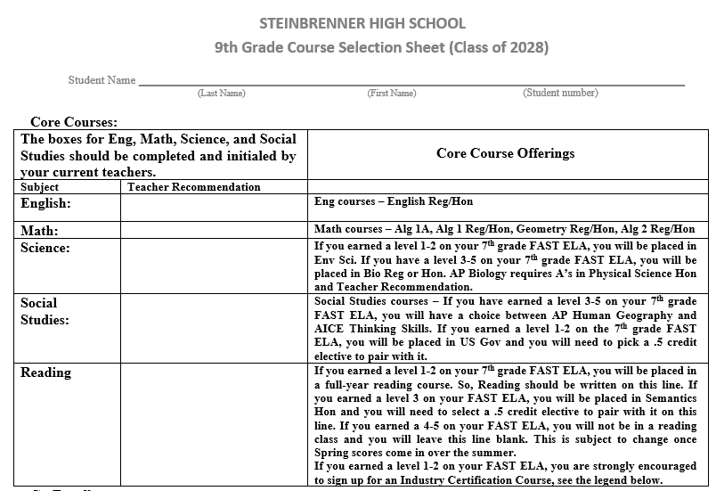

Slide 8
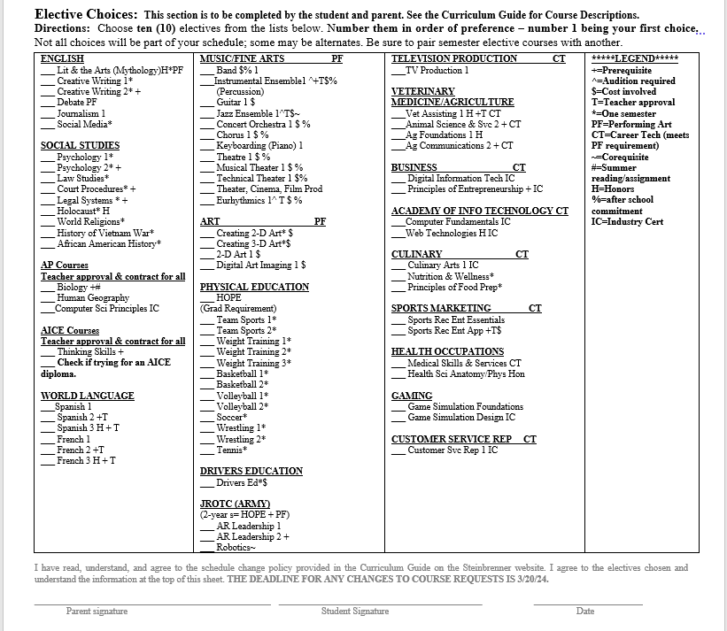

Slide 9
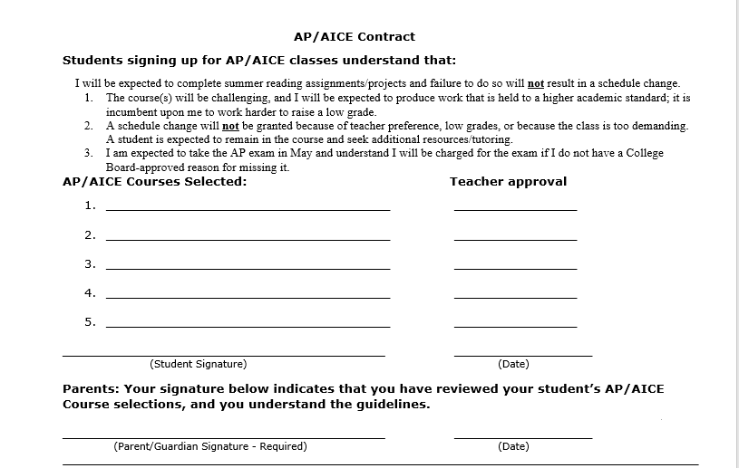

Slide 10
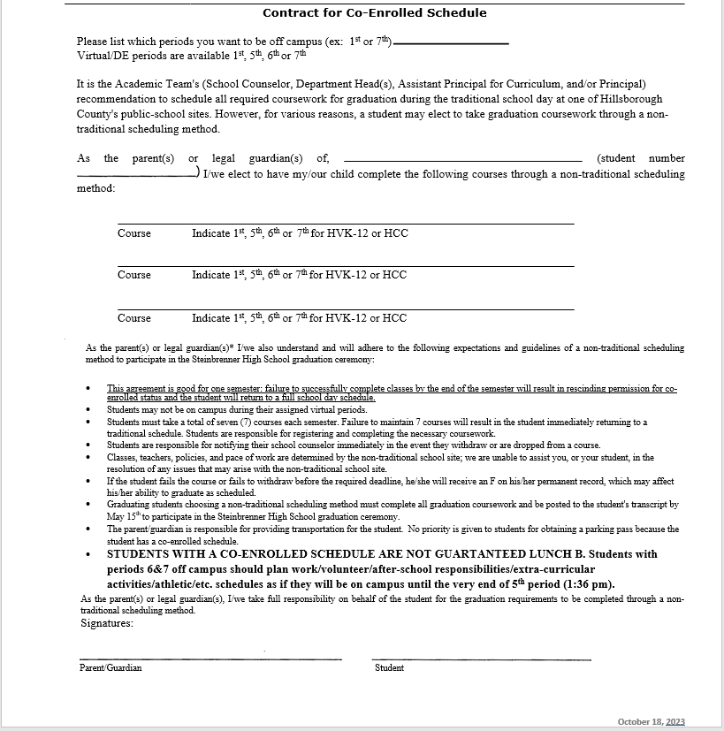

Slide 11
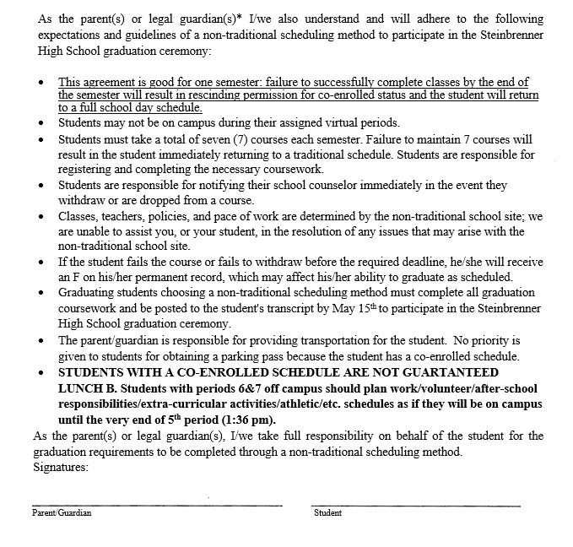

Slide 12
Deadlines
Middle Schools will determine a date for students to submit completed programming sheets.
Change requests are due by March 20, 2024 – This includes changes to elective choices or adding virtual periods.
Virtual period requests will not be accepted during the summer or at the start of the 24-25 school year.

